Slide 1
TMxxxx_Cyy Technology name:
Customer name: Project name
DRC waiver report
DRC decks used:

Slide 2
README
TSMC requires that non-trivial DRC violations that the end-customer wants to waive at his own risk are commented on and described as such.
This ppt template demonstrates on how to go about constructing such a form. TSMC will evaluate whether the listed violations can be waived for tape-out purposes.
Guidelines:
DRC clean designs is TSMC’s policy;
Violations in TSMC foundation IP that are described in the release notes as waivable and not caused by incorrect usage do not have to be included;
Guidelines, warnings and recommendations do not have to be included. Usually these are recognizable by the violation name or description e.g. esd.1g is a guideline;
Violations that will still be solved can be summarized in 1 table (no dedicated slides needed for those).
If applicable, the DRC failure report needs to be submitted by the deadline, at the latest.

Slide 3
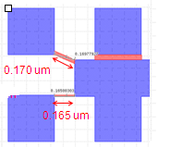
Device name: TMxxxx_Cyy
Violated rule: xxxxxx
Failed coordinate: (xxxx.xxxx,xxxx.xx)
Customer comment: reason to waive?
Only mention real DRC violations. Guidelines and warnings are waived by default.
Whole chip
Enlarge image (shows why violate)
Layers colors and names
TSMC min space:0.35um
Detailed dimensions are highly important!!
Rule violated

Slide 4
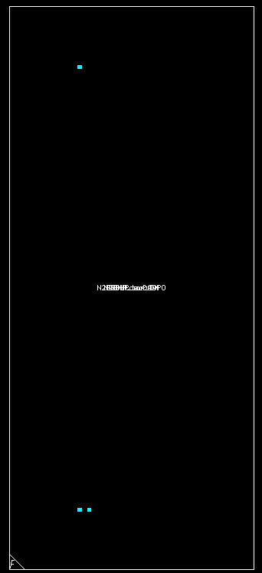
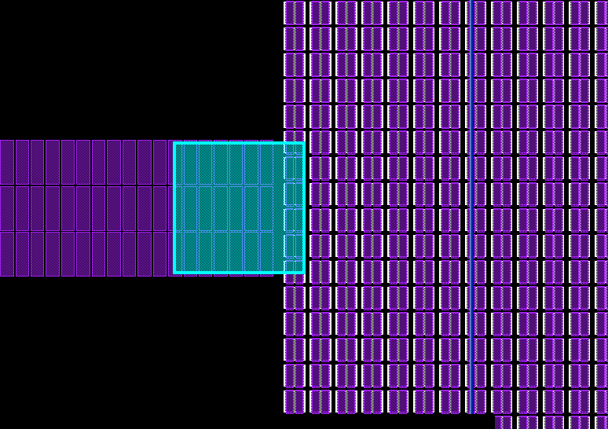
Device name: TMxxxx_Cyy
Violated rule: PO.DN.4.1
Failed coordinate: (xxxxx, xxxxxx)
Customer comment: The poly density (66%) of the small highlight region was over 65 % due to HiR resistor is besides MOS array (Customer required testline).
Example 1
Whole chip
Enlarge image (shows why violate)

Slide 5
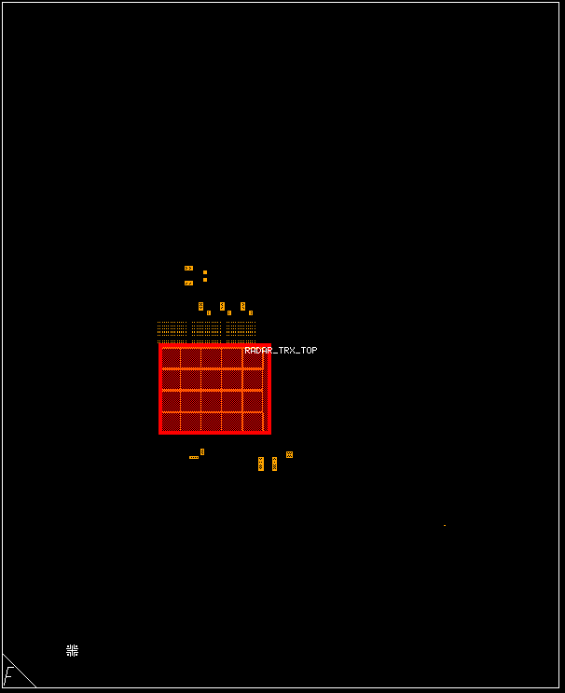
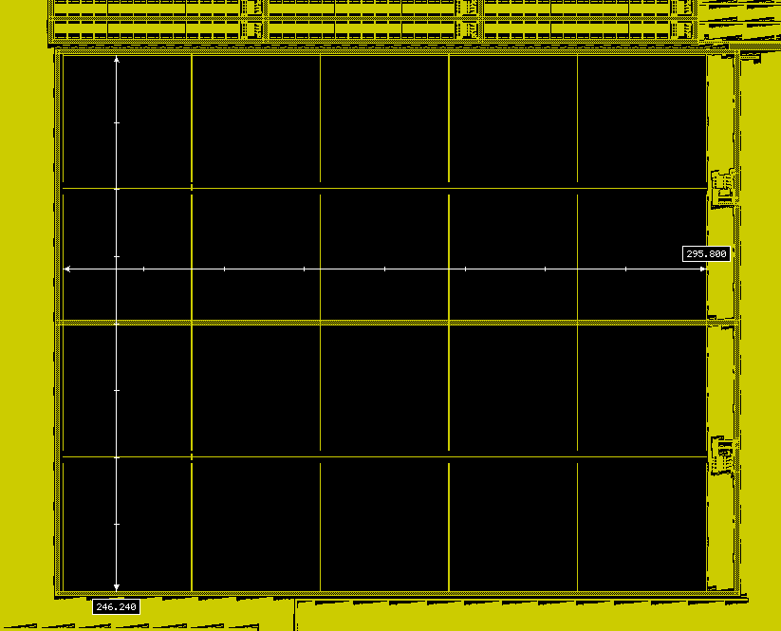
Device name: TMxxxx_Cyy
Violated rule: M2.DN.1
Failed coordinate: (408.831, 744.913)
Customer comment: Metal usage is reduced to a minimum in MOM cap region to reduce any parasitic
Example 2
Whole chip
Enlarge image (shows why violate)
Minimum local density [window 125 um x 125 um, stepping 62.5 um] >= 0.1

